Slide 1


5th Semester DBMS Mini Project ONLINE FIRE REPORTING SYSTEM
PRESENTED BY
BHOOMIKA B S
(1DB20IS028)
BI BI FATHIMA
(1DB20IS030)
GUIDED BY:
Mrs. Chaithra G V Assistant Professor and
Dr. Gowramma G S Associate Professor
Department of ISE, DBIT
Department of Information Science and Engineering
Don Bosco Institute of Technology, Mysore road, Kumbalagodu,Bangalore

Slide 2
AGENDA
INTRODUCTION
ABSTRACT
ER DIAGRAM
SCHEMA DIAGRAM
CONCLUSION

Slide 3
INTRODUCTION
An ONLINE FIRE REPORTING SYSTEM is a project to allow people to quickly and easily report fires to local fire departments.
This system will provide an easy-to-use from which will allow people to submit information about the fire, including its location, size, potential cause, and any other pertinent information.
Once the form is completed, the information will be sent to the appropriate fire department for immediate investigation.
The system will also be able to track the status of the fire report, and provide updates to the users as necessary.
This system will make it easier for people to contact the fire department in the event of an emergency, and will help to ensure that the fire department is altered to the situation in a timely manner.

Slide 4
ADVANTAGES
This project provides an online platform for Fire Department which allows the citizens to submit an ongoing fire incident.
This application helps the said department to manage the reports and assign their teams.
It has a pleasant user interface which helps of Bootstrap Framework and Admin LTE Template.
This system also allows for greater accuracy in tracking and analyzing fire data, which can be used to identify potential causes, determine trends, and plan for better public safety.
Other advantages include improved communication between responders and citizens, more efficient use of resources, and improved record keeping.

Slide 5
DISADVANTAGES
It includes cost, security risks, and compatibility issues.
Cost is the major factor, as this system require software, hardware, and other resources to be purchased and maintained.
Security risks are also a concern, as confidential information may be vulnerable to hacking or other malicious activities.

Slide 6
REQUIREMENT SPECIFICATION
HARDWARE REQUIREMENTS
Processor: Intel Core i5
RAM: 4 GB
Hard disc: 1TB
SOFTWARE REQUIREMENTS
Operating system: Windows 7 and above
Frontend Design: PHP
Backend Design: My SQL

Slide 7
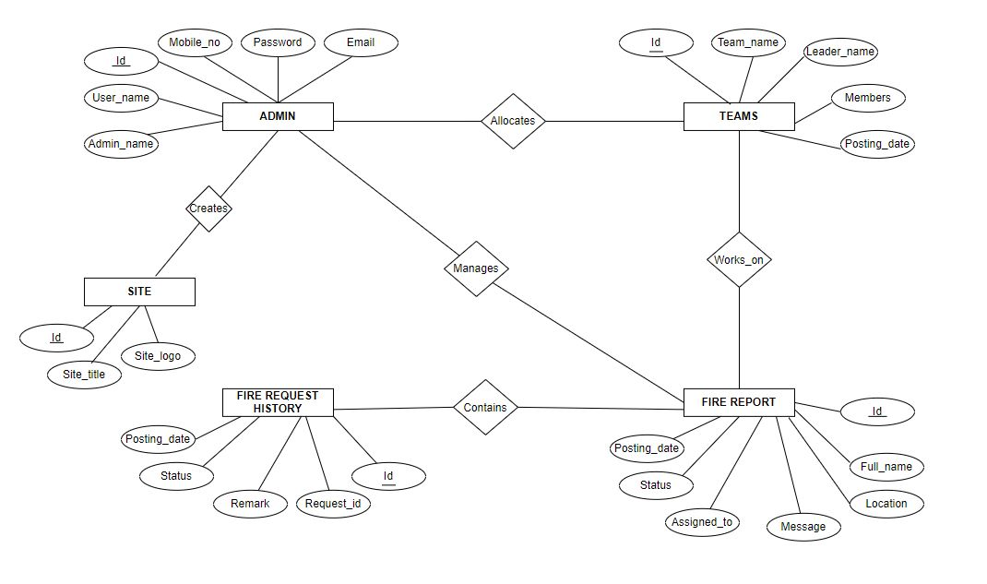
ER DIAGRAM

Slide 8
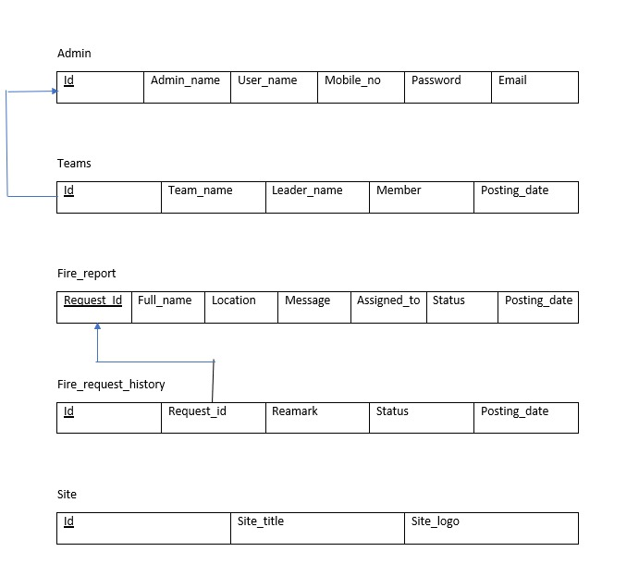
SCHEMA DIAGRAM

Slide 9
CONCLUSION
The conclusion for the online fire reporting system project is that it has been effective tool for quickly and efficiently gathering, organizing, and reporting fire-related data. It has allowed for a more comprehensive understanding of fire related activities and trends in an area as well as providing a convenient and efficient way to report fire incidents and potential risks. Additionally, it has enabled more effective collaboration between fire departments, allowing for more comprehensive fire prevention and response.

Slide 10
REFERENCE
Reference Book
1. Design patterns, Erich Gamma, Richard Helen, Ralph Johnson, person Publications, 2013.
2. HTML5: The Missing Manual, 2nd edition.
3. MySQL/PHP Applications.
4. Beginning PHP5, Apache and MySQL Web Development by Elizabeth Naramore.
5. Randy Connolly, Ricardo Hoar, Fundamentals of Web Development, 1St edition.
Website
http://ieeexplore.ieee.org
W3Schools.com
PHP project tutorials

Slide 11
THANK YOU

